Slide 1
Introduction to LPC2148

Slide 2
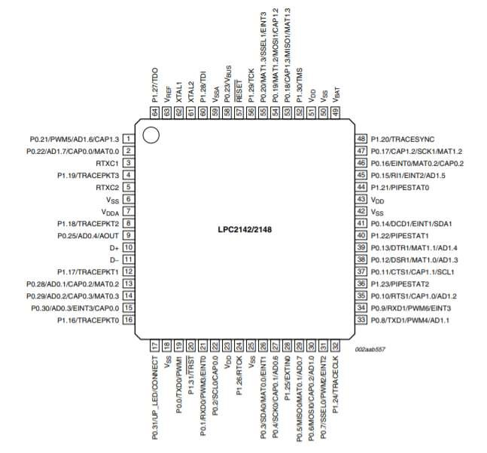
LPC2148

Slide 3
Introduction
ARM based microcontroller
LPC2148 is a 32-bit Microcontroller based on the ARM7TDMI-S Family.
It is manufactured by NXP (from Next eXPerience) Semiconductors (formerly Philips)
It is one of the widely used and highly successful ARM7 based Microcontroller.
Even though ARM7 family is considered obsolete with the introduction of many advanced processors and controllers, it is one of the best and easiest microcontrollers to work around for beginners in ARM based microcontrollers.
Due to their tiny size and low power consumption, LPC2142/2148 are ideal for applications where miniaturization is a key requirement, such as access control and point-of-sale

Slide 4
Specs of ARM 7 – LPC2148
Architecture: 16 bit/32bit ARM7TDMI-S
CPU Frequency: 60MHz
Number of GPIO pins: 45 (5V-Tolerant)
PWM Outputs:6
ADC (AD0,AD1): Two 14 channel (10-bit)
DAC: Single 10 bit DAC
USART Peripherals:2
I²C Peripherals:2 (40bit/s)
SPI Peripherals:1
SSP Peripherals:1
Timers:2 (32bit)
Flash Memory:512KB On chip flash m/y
RAM: 40kB On-chip Static RAM
Interrupt pins:21
Input voltage: 4.5V~6.5V

Slide 5
GPIO-(General Purpose Input-Output)
Input/output pins are the only way to interface with the microcontroller.
To Make The Microcontroller More Marketable, Most Ports Can Be Software-specified To Be Either Inputs Or Outputs.
Microcontrollers Use The Concept Of A Direction Register To Determine Whether A Pin Is An Input (Direction Register Bit Is 0) Or An Output (Direction Register Bit Is 1)
Each Digital Port Pin Has A Direction Bit. The Digital Port Pins On Most Microcontrollers Are Bidirectional.

Slide 6
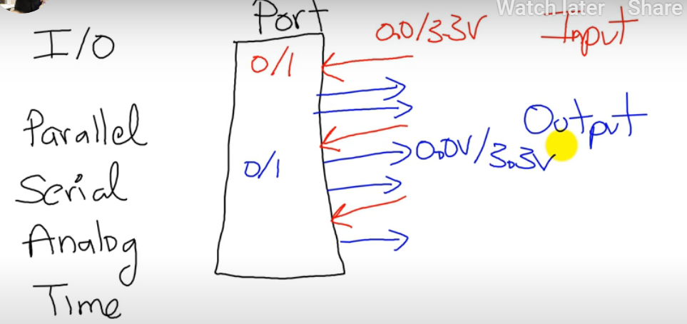
PORT
PORT means a register in Software sense.
It’s a set of pins or legs of IC, in Hardware sense !!!
There could be multiple ports for the same microcontroller.
We can configure legs of the Same one port as input or output Using a direction register.

Slide 7
Basic Concepts of Input and Output Ports
The Parallel Port: The Simplest I/O Port on a Microcontroller.
A Parallel I/O Port is a Simple Mechanism that allows the Software to interact with external Devices. It is called Parallel because multiple signals can be accessed all at once.
An Input Port, which allows the Software to Read External Digital Signals, Is Read Only.
That Means A Read Cycle Access From The Port Address Returns The Values Existing On the Inputs at that time.

Slide 8
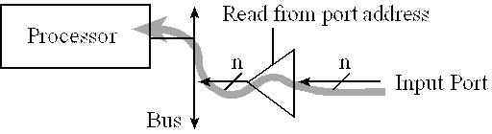
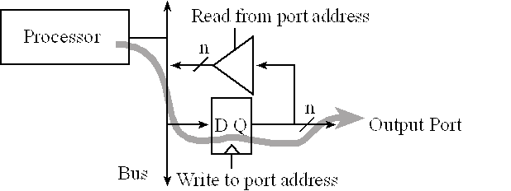
A read cycle access to an input port usually produces no effect.
The digital values existing on the input pins are copied into the microcontroller when the software executes a read from the port address.
A write cycle to the port address will affect the values on the output pins.
In particular, the microcontroller places information on the data bus and that information is clocked into the D flip-flops.

Slide 9
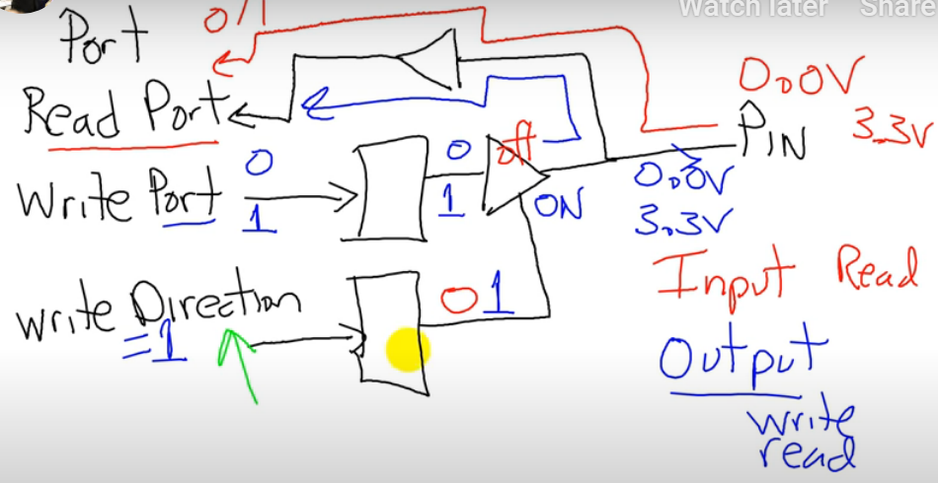
DIRECTION register :
To define the direction of Signal through a Pin.
If DIR=0 - its an input pin
If DIR=1 - its an output pin
If the pin is configured as output , both read and write operation is possible; where it can Read only the previous value.

Slide 10
/are invisible pins, remaining 29 are visible PORTS of LPC2148 (1/2)
LPC2148 has two IO Ports namely PORT0(P0) and PORT1(P1).
These two ports are of 32-bit wide and are provided by the 64 pins of the microcontroller.
Port 0 is a 32bit I/O port with individual direction controls for each bit.
Total of 28 pins of Port 0 can be used as a general purpose bi directional digital I/O while P0.31 provides digital output functions only.
The operation of Port 0 pins depends upon the pin function selected via the pin connector
Pins P0.24, P0.26 and P0.27 are not available /are invisible pins, remaining 29 are visible i/o pins

Slide 11
PORTS of LPC2148 (2/2)
Port 1 is a 32 bit bidirectional i/o port with individual direction controls for each bit.
The operation of Port 1 depends upon the pin function selected via to pin select. Pin 0 through 15 of port1 are not available/not visible and 16 to 31 pins are visible.
port 0 and port 1 are controlled by groups of registers.

Slide 12
LPC2148 has two IO ports namely PORT0 (P0) and PORT1 (P1). These two IO ports are of 32-bit wide and are provided by the 64 pins of the microcontroller.
The naming convention of the I/O pins on the LPC2148 Microcontroller is Pa.bc where ‘a’ is the number of the port i.e. 0 or 1 (as LPC2148 has only two ports) and ‘bc’ is the number of the pin in the port a. For example, P0.1 indicates pin number 1 of PORT0 and P1.10 indicates pin number 10 of PORT1.
[Refer the naming given in each pin to identify the corresponding port of LPC2148]

Slide 13
PORT0 is a 32-bit wide input/output port with dedicated direction control bits for each physical pin. Out of the 32 pins, 28 pins can be used as general purpose bidirectional I/O pins. Pin P0.31 is an output only pin. Pins P0.24, P0.26 and P0.27 of PORT0 are not available.
Figure shows pins of PORT 0
Are non available pins are not represented.

Slide 14
PORT1 is also a 32-bit wide input/output port. In PORT1, pins P1.0 to P1.15 are not available and pins P1.16 to P1.31 are the available general purpose input/output pins.
Find the pins for PORT1 yourself!!

Slide 15
Most of the pins in both the I/O ports of the LPC2148 have more than one function i.e. they are multiplexed with different functions. For example, Pin 19 of the LPC2148 has three functions namely P0.0, a general purpose I/O pin, TXD0, the transmitter O/P for UART0 and PWM1, the pulse width modulator O/P 1.
At any point of operation, each pin can have a single function

Slide 16
Pin Function Select Registers
At any point of operation, each pin can have a single function and the function can be selected with the help of three Configuration Registers which control the multiplexers to allow connection between the external pin and the on-chip peripheral.
The configuration register is called PINSEL
classified in to three registers: PINSEL0, PINSEL1 and PINSEL2
These configuration registers are of 32-bit wide
Any pin on the LPC2148 can have a maximum of 4 functions.
Hence in order to select one of the four functions, two corresponding bits of the PINSEL register are needed.
For example: pins 13, 14, 15 of LPC2148

Slide 17
Any pin on the LPC2148 can have a maximum of 4 functions.
Hence in order to select one of the four functions, two corresponding bits of the PINSEL register are needed.
For example: pins 13, 14, 15 of LPC2148
So, a 32-bit PINSEL register can control 16 pins with 2-bits to control each pin.
PINSEL0 controls PORT0 pins P0.0 to P0.15,
PINSEL1 controls PORT0 pins P0.16 to P0.31 and
PINSEL2 controls PORT1 pins P1.16 to P1.31.
Refer page 14 to 18 for more details of Pin function select register

Slide 18
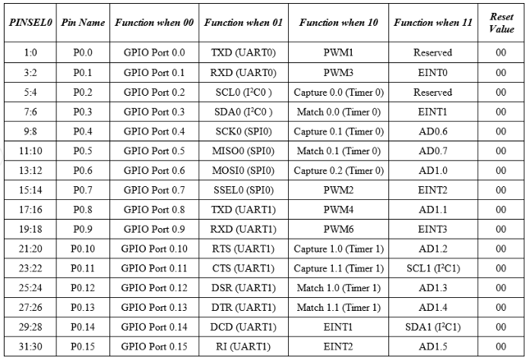
The following table shows the PINSEL0 and corresponding functions on the PORT0.
Refer page 14 to 18 for more details of PINSEL1

Slide 19
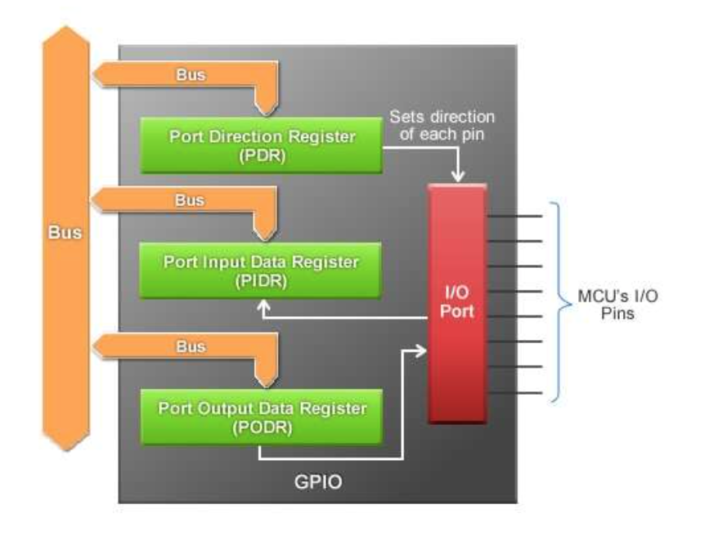

Slide 20
Fast and Slow GPIO Registers
There are 5 Fast (also called Enhanced GPIO Features Registers) GPIO Registers and 4 Slow (also called Legacy GPIO Registers) GPIO Registers available to control PORT0 and PORT1.
The default function of all the Pins is GPIO. But it is a good programming practice to mention “PINSEL0=0” in order to select the GPIO function of the Pins.
GPIO function is the most frequently used functionality of the microcontroller.
Slow GPIO Registers
The GPIO function in both the Ports are controlled by a set of 4 registers:
a) IOPIN,
b) IODIR,
c) IOSET and
d) IOCLR.

Slide 21
GPIO Register map (1/3)
IOPIN: This is GPIO Port Pin value register. The Current State of the GPIO configured port pins can always be read from this register, regardless of pin direction
IODIR: This is GPIO Port Direction control register. This register individually Controls the direction of each port pin
IOCLR: This is GPIO Port Output Clear registers. This register controls the state of output pins. Writing ones produces lows at the corresponding port pins and clears the corresponding bits in the IOSET register. Writing zeroes has no effect.
IOSET: This is GPIO Port Output Set registers. This register controls the state of output pins in conjunction with the IOCLR register. Writing ones produces highs at the corresponding port pins. Writing zeroes has no effect.

Slide 22
IOxPIN (GPIO Port Pin value register):
This is a 32-bit wide register. This register is used to read/write the value on Port (PORT0/PORT1). But care should be taken while writing. Masking should be used to ensure write to the desired pin.
IOPIN: It is a GPIO Port Pin Value register and can be used to read or write values directly to the pin. The status of the Pins that are configured as GPIO can always be read from this register irrespective of the direction set on the pin (Input or Output)
The syntax for this register is IOxPIN, where ‘x’ is the port number i.e. IO0PIN for PORT0 and IO1PIN for PORT1.
Examples :
a) Writing 1 to P0.4 using IO0PIN
IO0PIN = IO0PIN | (1<<4)
b) Writing 0 to P0.4 using IO0PIN
IO0PIN = IO0PIN & (~(1<<4) )
c) Writing F to P0.7-P0.4
IO0PIN = IO0PIN | (0x000000F0)

Slide 23
2. IOxSET (GPIO Port Output Set register) :
IOSET: It is a GPIO Port Output Set Register and can be used to set the value of a GPIO pin that is configured as output to High (Logic 1). When a bit in the IOSET register is set to ‘1’, the corresponding pin is set to Logic 1. Setting a bit ‘0’ in this register has no effect on the pin.
The syntax for this register is IOxSET, where ‘x’ is the port number i.e. IO0SET for PORT0 and IO1SET for PORT1.
3. IOxDIR (GPIO Port Direction control register)
IODIR: It is a GPIO Port Direction Control register and is used to set the direction i.e. either input or output of individual pins. When a bit in this register is set to ‘0’, the corresponding pin in the microcontroller is configured as Input. Similarly, when a bit is set as ‘1’, the corresponding pin is configured as Output.
The syntax for this register is IOxDIR, where ‘x’ is the port number i.e. IO0DIR for PORT0 and IO1DIR for PORT1.

Slide 24

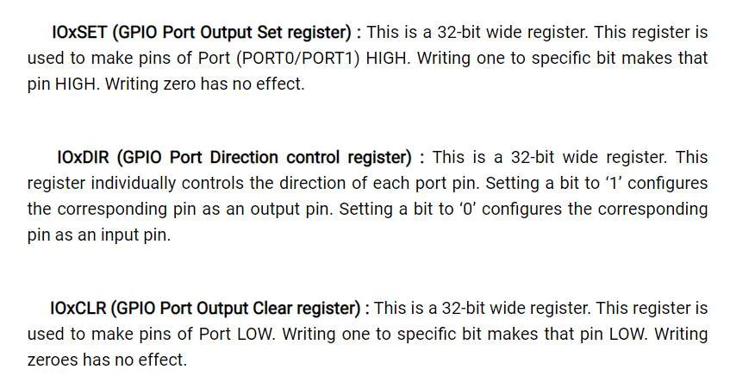




Slide 25
4. IOxCLR (GPIO Port Output Clear register)
IOCLR: It is a GPIO Port Output Clear Register and can be used to set the value of a GPIO pin that is configured as output to Low (Logic 0). When a bit in the IOCLR register is set to ‘1’, the corresponding pin in the respective Port is set to Logic 0 and at the same time clears the corresponding bit in the IOSET register. Setting ‘0’ in the IOCLR has no effect on the pin.
The syntax for this register is IOxCLR, where ‘x’ is the port number i.e. IO0CLR for PORT0 and IO1CLR for PORT1.
Examples :
a) Configure pin P0.0 to P0.3 as input pins and P0.4 to P0.7 as output pins.
IO0DIR = 0x000000F0;
b) Configure pin P0.4 as an output. Then set that pin HIGH.
IO0DIR = 0x00000010; OR IO0DIR = (1<<4);
IO0SET = (1<<4);
c) Configure pin P0.4 as an output. Then set that pin LOW.
IO0DIR = 0x00000010; OR IO0DIR = (1<<4);
IO0CLR = (1<<4);

Slide 26
GPIO Register map (2/3)
IO0DIR
IO0DIR is used to configure pins of Port 0-P0 as input or output pins.
1= Output Pin, 0= Input Pin
Example: IO0DIR= 0x0000FFFF means P0.0 to PO.15 are configured as output pins and P0.16 to P0.31 are configured as input pins.
IO1DIR
It is used to configure pins of Port 1- P1 as input or output pins
1= Output Pin, 0= Input Pin
Example: IO1DIR=0xAAAAAAAA means even pins(P1.0, p1.2 etc.) are configured as i/p pins and odd pins (P1.1, P1.3 etc.) are configured as o/p pins.

Slide 27
GPIO Register map (3/3)
IO0SET
It is used to set pins of Port0 – P0 to logic 1.
Example: IO0SET= 0x0000FFFFwill set pins P0.0 to P0.15 at logic 1. It will not affect other pins.
IO0CLR
It is used to set pins of Port0 – P0 to logic 0.
Example: IO0CLR=0x0000FFFFwill set pins P0.0 to P0.15 at logic 0. It will not affect other pins.

Slide 28
An important note to remember is that since the LPC2148 is a 32-bit microcontroller, the length of all the registers mentioned is also 32-bits. Each bit in the above mentioned registers is directly linked to the corresponding pin in the microcontroller i.e. bit ‘a’ in IO0SET corresponds to Pin ‘a’ in the PORT0.
Registers in LPC2148 follow Big Endian format i.e. bit 0 is the LSB on the extreme right of the register and bit 31 is the MSB on the extreme left of the register.
Another important note is that when reset, all the pins are set as GPIO pins and the direction of each pin is set as Input.

Slide 29
Now, we’ll see how to use the above mentioned registers in programming. First, is to set the direction of a pin. For example, if we want to set 4th pin of PORT0 i.e. P0.3 as output, then it can be set in various ways as shown below.
Method 1: IO0DIR = (1<<3);
This is a direct assignment method where the binary value (1) is set directly on the pin. All the other pins are set to 0. This method should be avoided as the value is directly being assigned in the register and while P0.3 is assigned as ‘1’, all the other pins are forced to be assigned ‘0’.
An alternative to this method is ORing the register and then assigning the value. This can be done in two ways.
Method 2: IO0DIR | = 0x00000008;
In this method, the hexadecimal value of the register is assigned after OR-ing the register with desired hexadecimal number. In this way, the other pins other than the desired pin (P0.3 in this case) are not affected. This method is useful if we want to assign many pins without affecting the other pins.
(equivalent to IO0DIR = IO0DIR | 0x00000008)

Slide 30
Method 3: IO0DIR | = (1<<3);
This is similar to the above method except that only a single pin is affected.
Other registers can also be set using the same methods. Now, we’ll see an example of setting pin 15 of PORT0 i.e. P0.15 as output and drive the pin High.
For this we need to use two registers: IODIR and IOSET.
IO0DIR | = (1<<15); // Configuring P0.15 as output.
IO0SET | = (1<<15); // Make the O/P pin P0.15 as High
We’ll see another example where pin 11 of PORT0 is set as output and the output of this pin is set to logic 1 and then to logic 0.
For this we need to use three registers: IODIR, IOSET and IOCLR.
IO0DIR | = (1<<11); // Configuring P0.11 as output.
IO0SET | = (1<<11); // Make the O/P pin P0.11 as High.
IO0CLR | = (1<<11); // Make the O/P pin P0.11 as Low.
Now, we’ll see an example where more than one pin has to be set as output and the value of that pin must be HIGH. Consider pins 7 and 14 of PORT0 (P0.7 and P0.14).
IO0DIR | = (1<<7) | (1<<14); // Configuring pins P0.7 and P0.14 as output.
IO0SET | = (1<<7) | (1<<14); // Make the O/P of pins P0.7 and P0.14 as High.

Slide 31
Examples
Example: IO0DIR=0x0000FFFF means P0.0 to P0.15 are configured as output pins and P0.16 to P0.31 are configured as input pins.
Example: IO1DIR=0xAAAAAAAA means even pins (P1.0, P1.2, P1.4 etc.) are configured as input pins and odd pins (P1.1, P1.3, P1.5 etc.) are configured as input pins.
IO0CLR=0x0000FFFF will set pins P0.0 to P0.15 at logic 0. It will not affect other pins.

Slide 32
Once we have seen how to set the direction of pins, setting the pin as High or Low, now we’ll jump into real time embedded programming. Similar to “Hello, World” program in C Language, blinking an LED is the basic program in embedded system.

Slide 33
Example: Blink LEDs connected on pins
Step-1: Select the GPIO PORT Pins using PINSEL1.
Step-2: Specify the direction of pins as output using IO1DIR.
Step-3: Set desired pins using IO1SET.
Step-4: Clear desired pins using IO1CLR.
Step-5: Go to step-2.

Slide 34
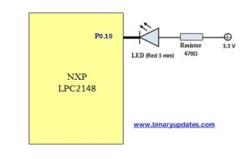
Example: Blink LEDs connected on pins

Slide 35
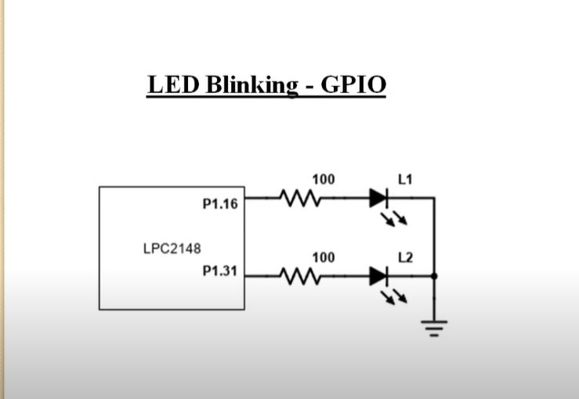
Experiment
Connect 16 from pin 16 to pin 31 of port 1

Slide 36
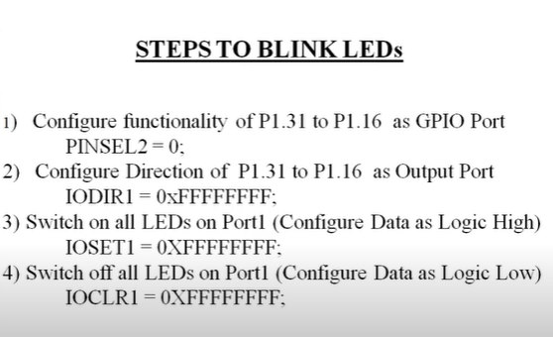

Slide 37
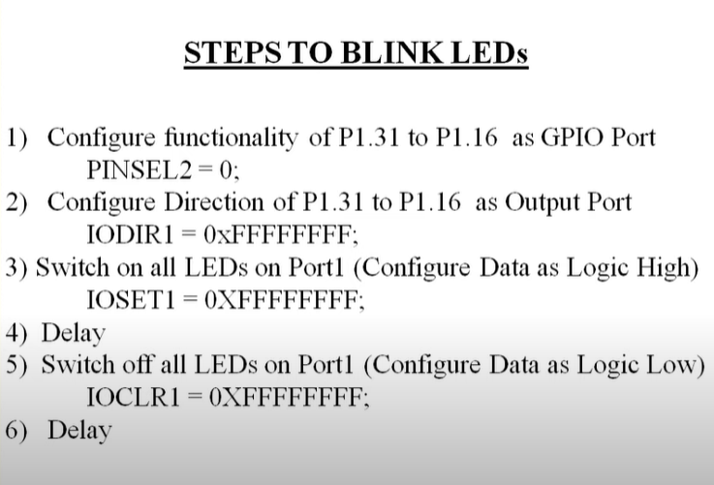

Slide 38
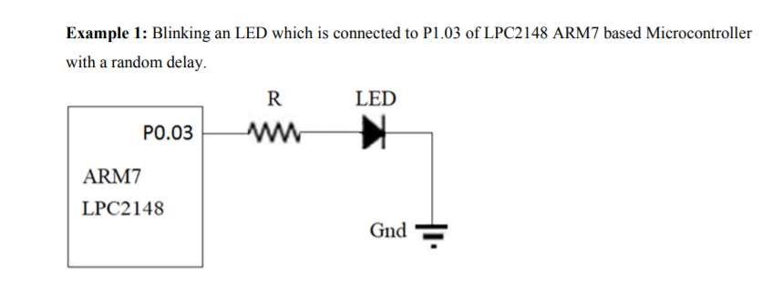
Chinmayi R , ECE, ASE, Amritapuri

Slide 39

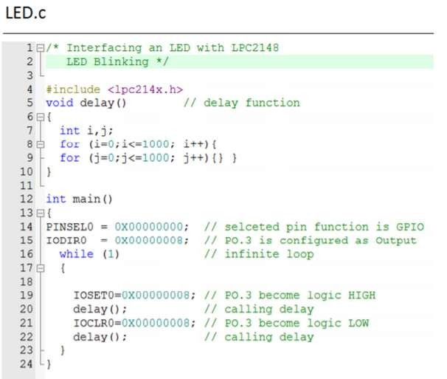






Example1

Slide 40
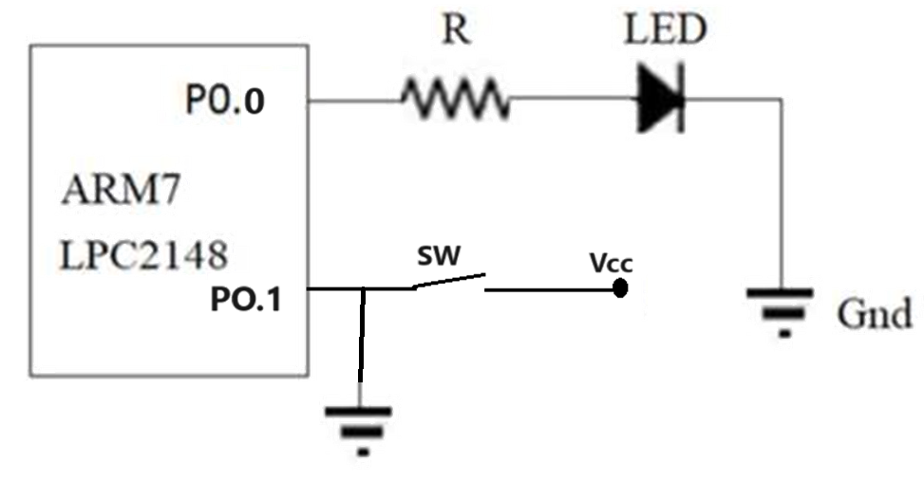
Example 2: Turn on the LED based on the switch input

Slide 41
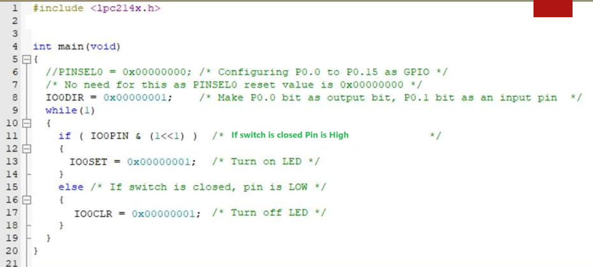

Slide 42
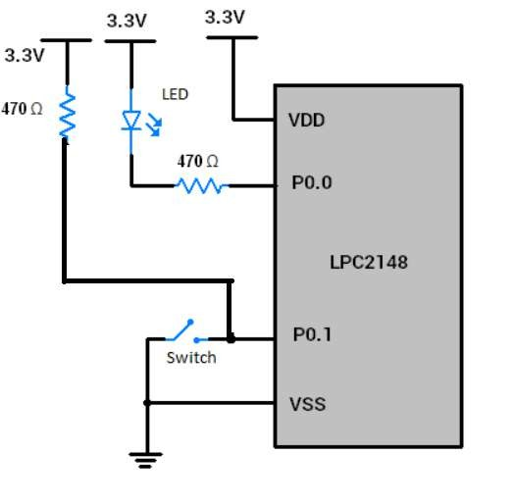
Example3:

Slide 43
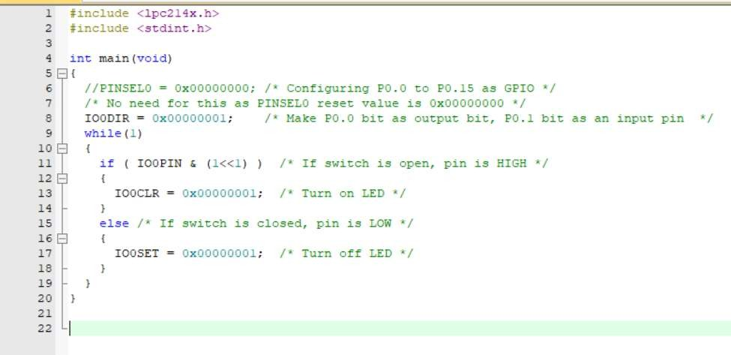

Slide 44
Exercise
Blink five LEDs in ascending and descending order: Write a code to turn on
one LED at a time, starting from LED0, then LED1, until you reach LED5. Then, you should turn on LED4, then LED3, and so on until you reach LED0. Each LED should be on for 100ms. Repeat this pattern in an infinite loop.

Slide 45
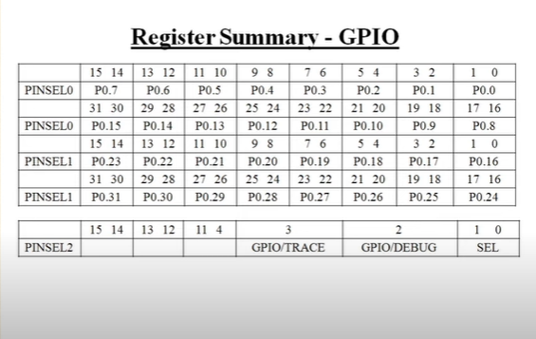

Slide 46
Thank You

Slide 47
C batch-1,3,11,14,25,28,31,33,41,42,47,50,53,54,59,65,69,76,
A Batch – 8,10,29,64,65,76,80

